Slide 1
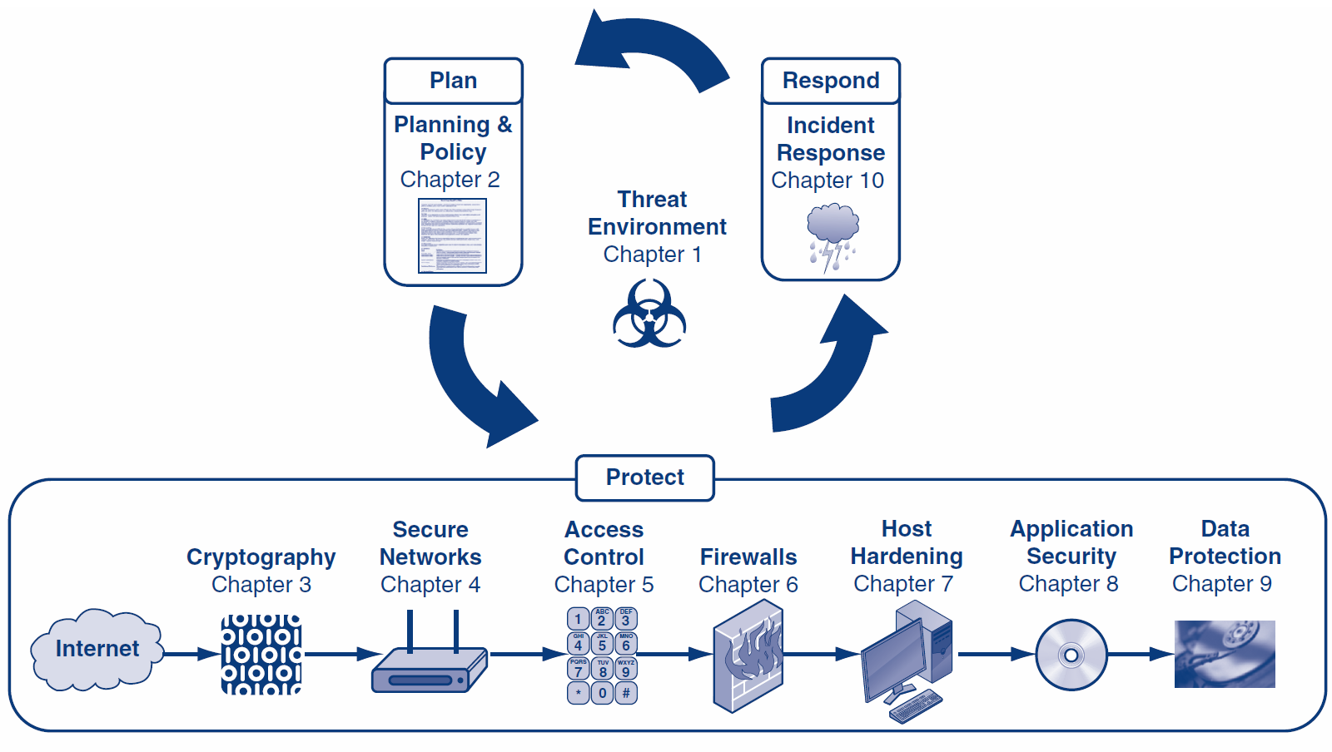
Chapter 2

Slide 2
Orientation
The first chapter focused on threats
The rest of the book focuses on defense
Today, we will see that defensive thinking is build around the plan-protect-respond cycle
Chapters 3 to 9 focus on protection
Chapter 10 focuses on response

Slide 3
Planning and Policy
Corporate Computer Security, 4th Edition
Randall J. Boyle & Raymond R. Panko
Chapter 2

Slide 4
Learning Objectives
Outline need for formal management processes.
Explain the plan–protect–respond security management cycle.
Describe:
compliance laws and regulations.
organizational security issues.
risk analysis.
technical security infrastructure.
Explain policy-driven implementation.
Know governance frameworks.

Slide 5
2.1: Management is the Hard Part
Technology Is Concrete
Can visualize devices and transmission lines
Can understand device and software operation
Management Is Abstract
Management Is More Important
Security is a process, not a product (Bruce Schneier)

Slide 6
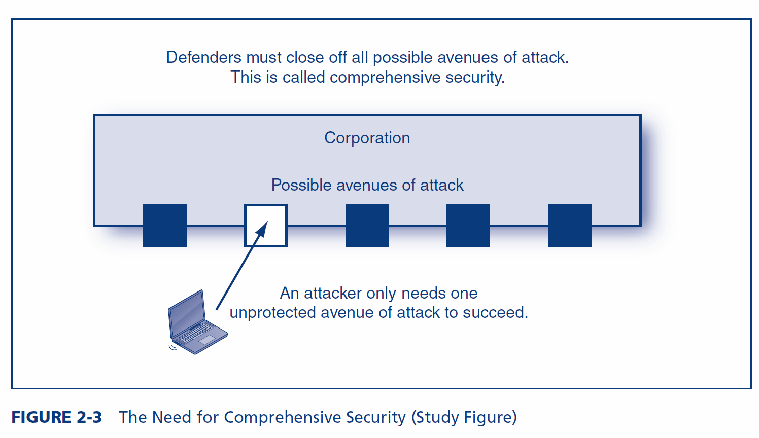
2.1: The Need for Comprehensive Security

Slide 7
2.1: Weakest Link Failure
Hence, we can say that the security of a system is determined by the security of the weakest attack avenue, i.e., the weakest link
If an attack on the system exploits a vulnerability in the weakest link, the security failure is a weakest link failure.

Slide 8
2.1: Security Management Is a Disciplined Process
Complex
Cannot be managed informally
Need Formal Processes
Planned series of actions in security management
Annual planning
Processes for planning and developing individual countermeasures

Slide 9
2.1: Security Management Is a Disciplined Process
A Continuous Process
Fail if let up
Compliance Regulations
Add to the need to adopt disciplined security management processes

Slide 10
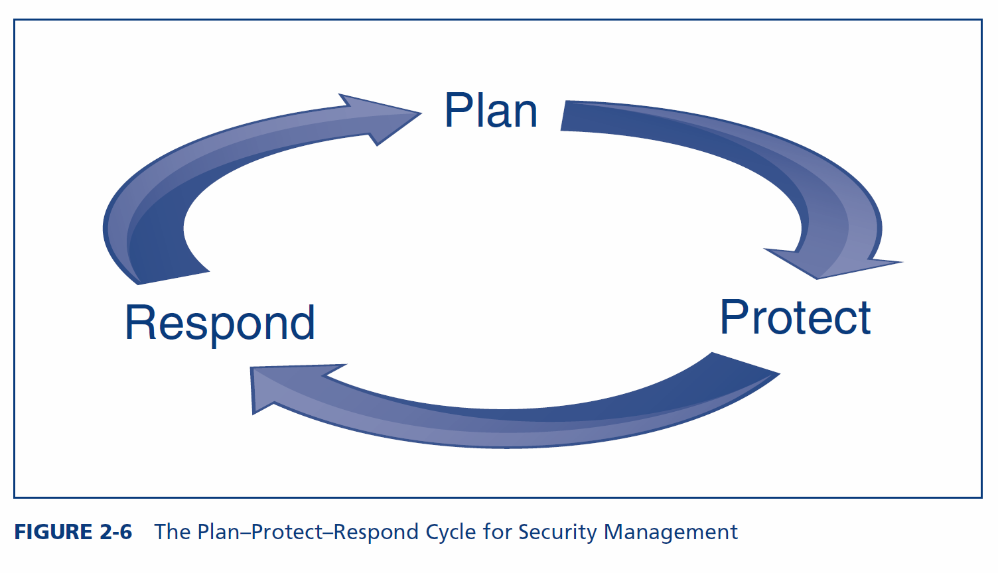
2.1: The Plan-Protect-Respond Cycle for Security Management
Dominates security management thinking

Slide 11
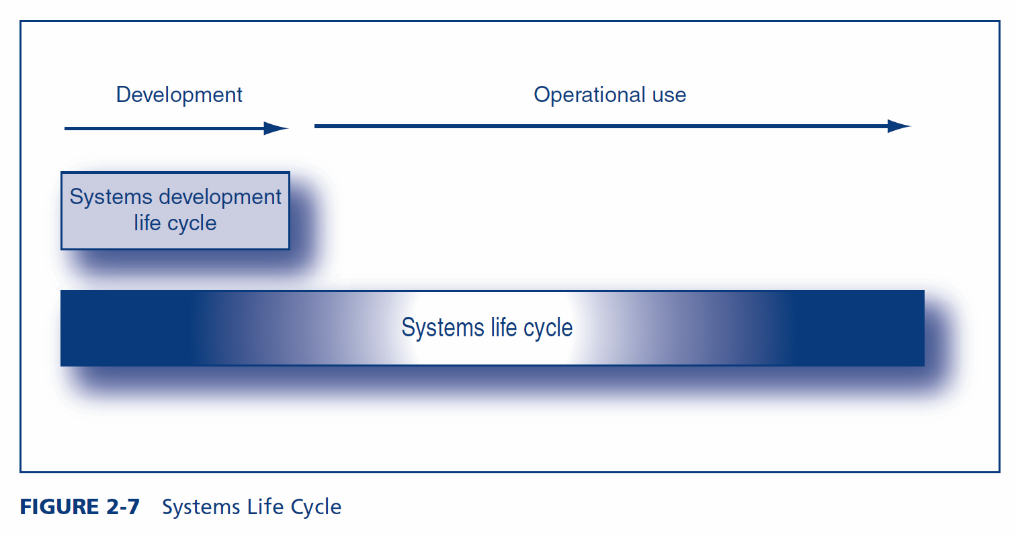
2.1: Systems Life Cycle
The systems life cycle goes beyond the SDLC, to include operational use. SLC thinking is critical in security.
Notes:
The security should plan should cover the entire life cycle of a system, not just the development.

Slide 12
2.1: Vision
Vision
Your understanding about your role with respect to your company, its employees, and the outside world drives everything else

Slide 13
2.1: Vision
Security as an Enabler
Security is often thought of as a preventer
But security is also an enabler
A company with good security can do things otherwise impossible
Engage in interorganizational systems with other firms
Can use SNMP SET commands to manage systems remotely
Must get in early on projects to reduce inconvenience

Slide 14
2.1: Vision
Positive Vision of Users
Must not view users as malicious or stupid
Stupid means poorly trained, and that is security’s fault
Must have zero tolerance for negative views of users
Cannot Be Effective Unless Users Work with You
Consultation, consultation, consultation

Slide 15
2.1: Vision
Should Not View Security as Police or Military Force
Creates a negative view of users
Police merely punish, they do not prevent crime; security must prevent attacks
Military can use fatal force; security cannot even punish (HR does that)

Slide 16
2.1: Vision
Cannot Be Effective Unless Users Work with You
Consultation, consultation, consultation

Slide 17
2.1: Strategic IT Security Planning
Identify Current IT Security Gaps
Identify Driving Forces
The threat environment
Compliance laws and regulations
Corporate structure changes, such as mergers
Identify Corporate Resources Needing Protection
Enumerate all resources
Rate each by sensitivity

Slide 18
2.1: Strategic IT Security Planning
Develop Remediation Plans
Develop a remediation plan for all security gaps
Develop a remediation plan for every resource unless it is well protected
Develop an Investment Portfolio
You cannot close all gaps immediately
Choose projects that will provide the largest returns
Implement these

Slide 19
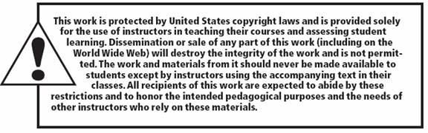
Copy Right Statement
All rights reserved. No part of this publication may be reproduced, stored in a retrieval system, or transmitted, in any form or by any means, electronic, mechanical, photocopying, recording, or otherwise, without the prior written permission of the publisher. Printed in the United States of America.
Copyright © 2015 Pearson Education, Inc.

